Slide 2
PAI Presentation Graphics
UX

Slide 3



















Boxes

Slide 4




























Other Components
With Shadow
Without Shadow

Slide 5














Other Components

Slide 6




































































Logos

Slide 7







































Icons

Slide 8
Images-Click on link to view approved images
Illustrations

Slide 9









Heading
IAM

Slide 10



Template

Slide 11

Template

Slide 12





Template

Slide 13

Template

Slide 14
Template
< 14

Slide 15
Template

Slide 16







Template

Slide 17
Modules
Summary

Slide 19
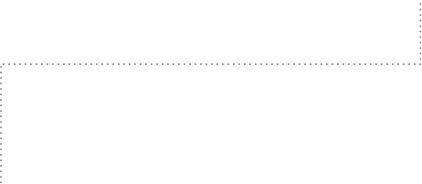
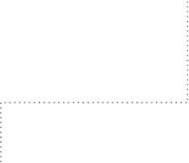
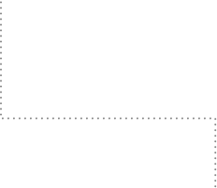
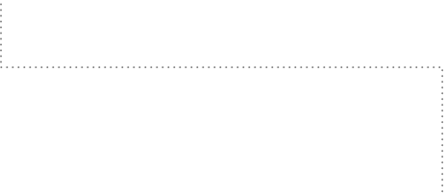





KEY FEATURES

Slide 21
Vision
Mission
Strategy

Slide 22
Entity Inventory
Mission
Vision
Strategy

Slide 23
Proposed Roadmap
Date
Date
Date
Date
Date
Title
Title
Title
Title
Title
Title

Slide 24
Proposed Roadmap
Q1 202x
Q2 202x
Q3 202x
Q4 202x
Visibility to Critical Entities &
Relationships
\
\
Extending Data Source Support
\
\
Improve Client
Experience
Improve End User Experience
Priority (Subject to Dependencies, Scope changes and Resources)
Big Ticket Item

Slide 25












Roadmap
24-May-23
12-Jun-23
07-Jun-23
12-May-23
26-Apr-23
08-Jun-23
20-Jun-23
31-May-23

Slide 26










Roadmap

Slide 27








Engagement Roadmap

Slide 28
Streaming & Batch
Flow 1
Flow 2
Flow 3

Slide 29







Solutions
Solution Team
Projects
Solutions Repo
Late 2010’s
Test Case

Slide 30
Strategy to Business
Visibility to Critical Entities
^{Extending Vendor Support}
^{Improve Client Experience}
^{Improve End User Experience}
Strategy
Input
Value
Goals
Goals
Goals
Goals

Slide 31

EI
Without Entity Inventory
Data Sources
*(Dummy text)Complex Structure
Use Cases
With Entity Inventory
Data Sources
Cleansing Normalising Entity Resolution
Entity Inventory
Use Case

Slide 32
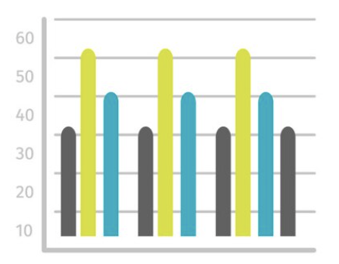

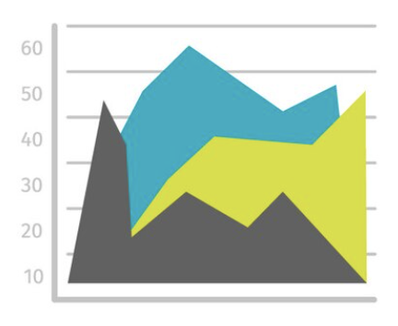


Visual analytics
Rich Visual Analytics library that can easily integrate with SCB data landscape
Global Component Library
Global Filter Component
Solution Composition
Entity Explorer
Asset Management
Vulnerability Analytics
Controls Monitoring
Late 2010’s
Table Components

Slide 33
Text
Text
Description
Text
Text
Text
Text
Text
Text
Description
Text
Text
Text
Description
Data Warehouses

Slide 34


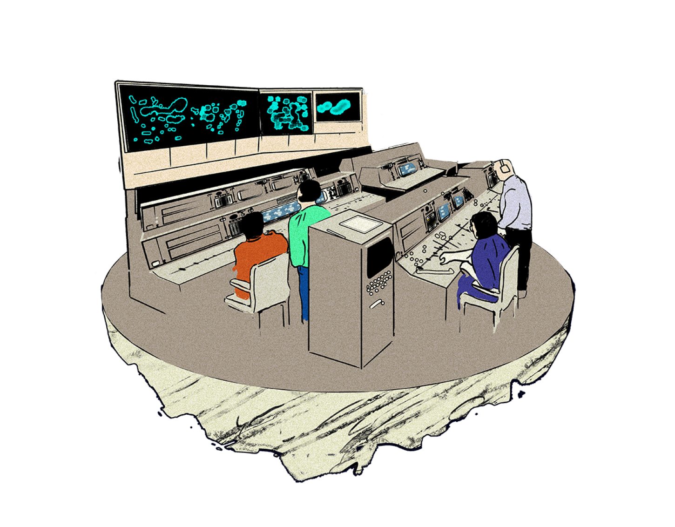
Workflow
Text
Text
Text
Text
Text
Text
Text
Text

Slide 35







4
Text
Text
5
3
Text
Tex
MaintText
enance
2
6
Text
Text
1

Slide 36






4
Text
Text
5
3
Text
Text
2
6
Text
Text
1

Slide 37
Challenges we Address
Text
Text
Lack of Product Flexibility
Text
Cost (Security Product Sprawl)
Text
Data Platform Lock-in (e.g., Splunk)
Text
Garbage in, Garbage out
Text
Text
Text
Text
Text
Text
Text
Text
Text
Text
Text

Slide 38

Organisational Structure
Text
Text
Text
Text
Text
Text
Text
Text
Text
Text
Text
Text
Text
Text
Text
Text
Text
Text

